Slide 1
Mortgage Rate Sensitivity of U.S. Metro Housing Price Growth
QM 2023 Capstone Milestone 4
Kenzie, Reese, Carter
April 29, 2026

Slide 2
Research Question & Policy Focus
How sensitive are regional home prices to changes in 30-year mortgage rates, and how should policy respond?
Audience: Federal Reserve / Housing Policy Analysts
Scope: 894 U.S. metros, quarterly data 2000Q1–2026Q1 (74,991 observations)
Method: Two-way fixed effects regression with lagged mortgage rates

Slide 3
Data & Sample Construction
Primary Data
Key Variables
Zillow metro price index
FRED mortgage rates
894 U.S. metros
102 quarters
Outcome: quarterly price growth
Treatment: mortgage rate lag-3
Controls: price growth lag-1
Fixed effects: metro & quarter

Slide 4
Key Finding: Mortgage Rate Sensitivity (Model A)
A 1 percentage point increase in the 30-year mortgage rate (lagged 3 quarters) is associated with a 0.11 percentage point reduction in quarterly metro housing price growth
Coefficient: -0.1077
t-statistic: -16.77
p-value: < 0.001 ***
Economic Implications:
1 percentage point rate increase → 0.11 pp lower quarterly growth
2022-2023 rate cycle (3.48 pp) → 0.56–0.71 pp drag on quarterly growth
Effect is highly statistically and economically significant

Slide 5
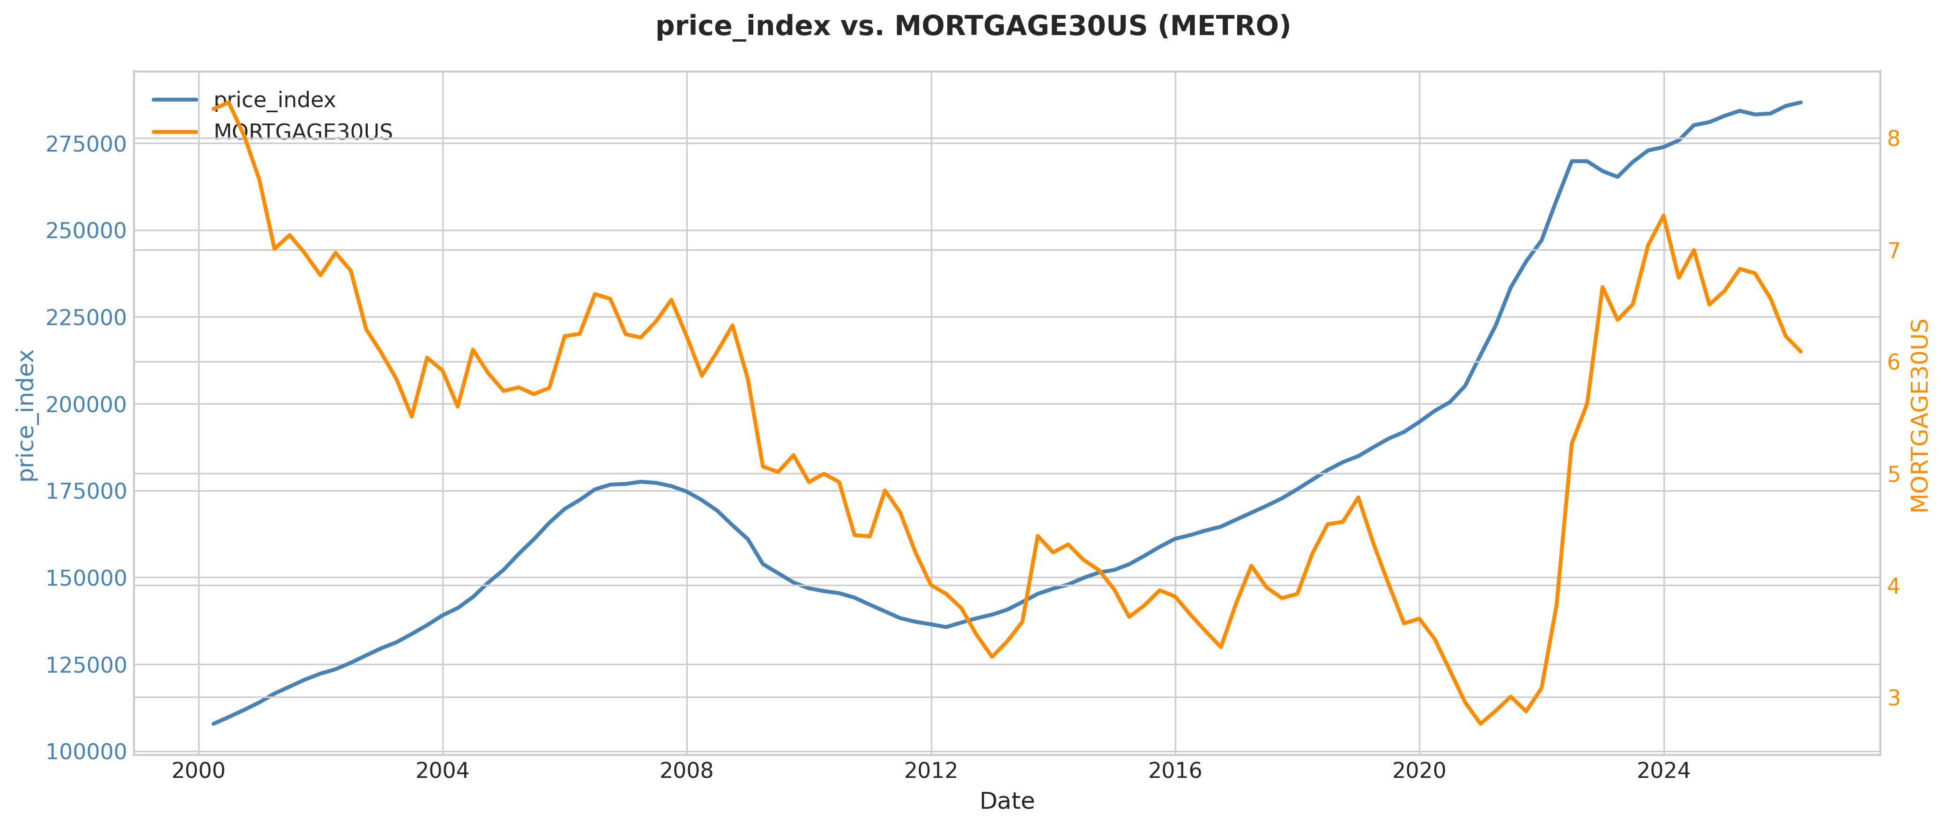
Mortgage Rate Transmission to Housing Markets
What to See:
Inverse relationship: when rates spike, price growth falls
The 2022-2023 surge in rates triggered a sharp decline in housing momentum
Effects take time—prices don't respond immediately, but they respond decisively

Slide 6
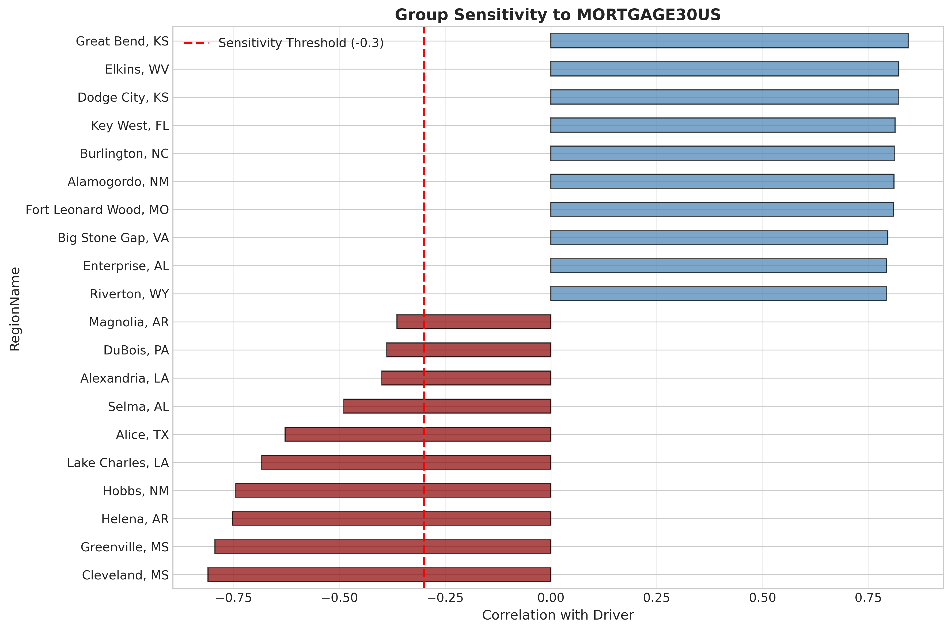
Regional Heterogeneity in Rate Sensitivity
Key Observation
Suburban areas show 4× higher sensitivity to rate changes
Urban centers withstand rate shocks better due to supply constraints and strong demand
Policy must target support to high-sensitivity regions where affordability stress is greatest

Slide 7
Differential Effects: High-Sensitivity Metros (Model B DiD)
High-exposure metros experienced 0.40 percentage points lower quarterly growth 2022 rate tightening relative to low-exposure metros
t-statistic: -14.14
p-value: < 0.001 ***
Treated×Post: -0.4000
Interpretation:
Suburban/exurban markets with elastic supply show larger rate sensitivity
Urban/constrained-supply markets are more resilient to rate tightening
Caution: Pre-trend diagnostics suggest parallel trends assumption may be violated

Slide 8
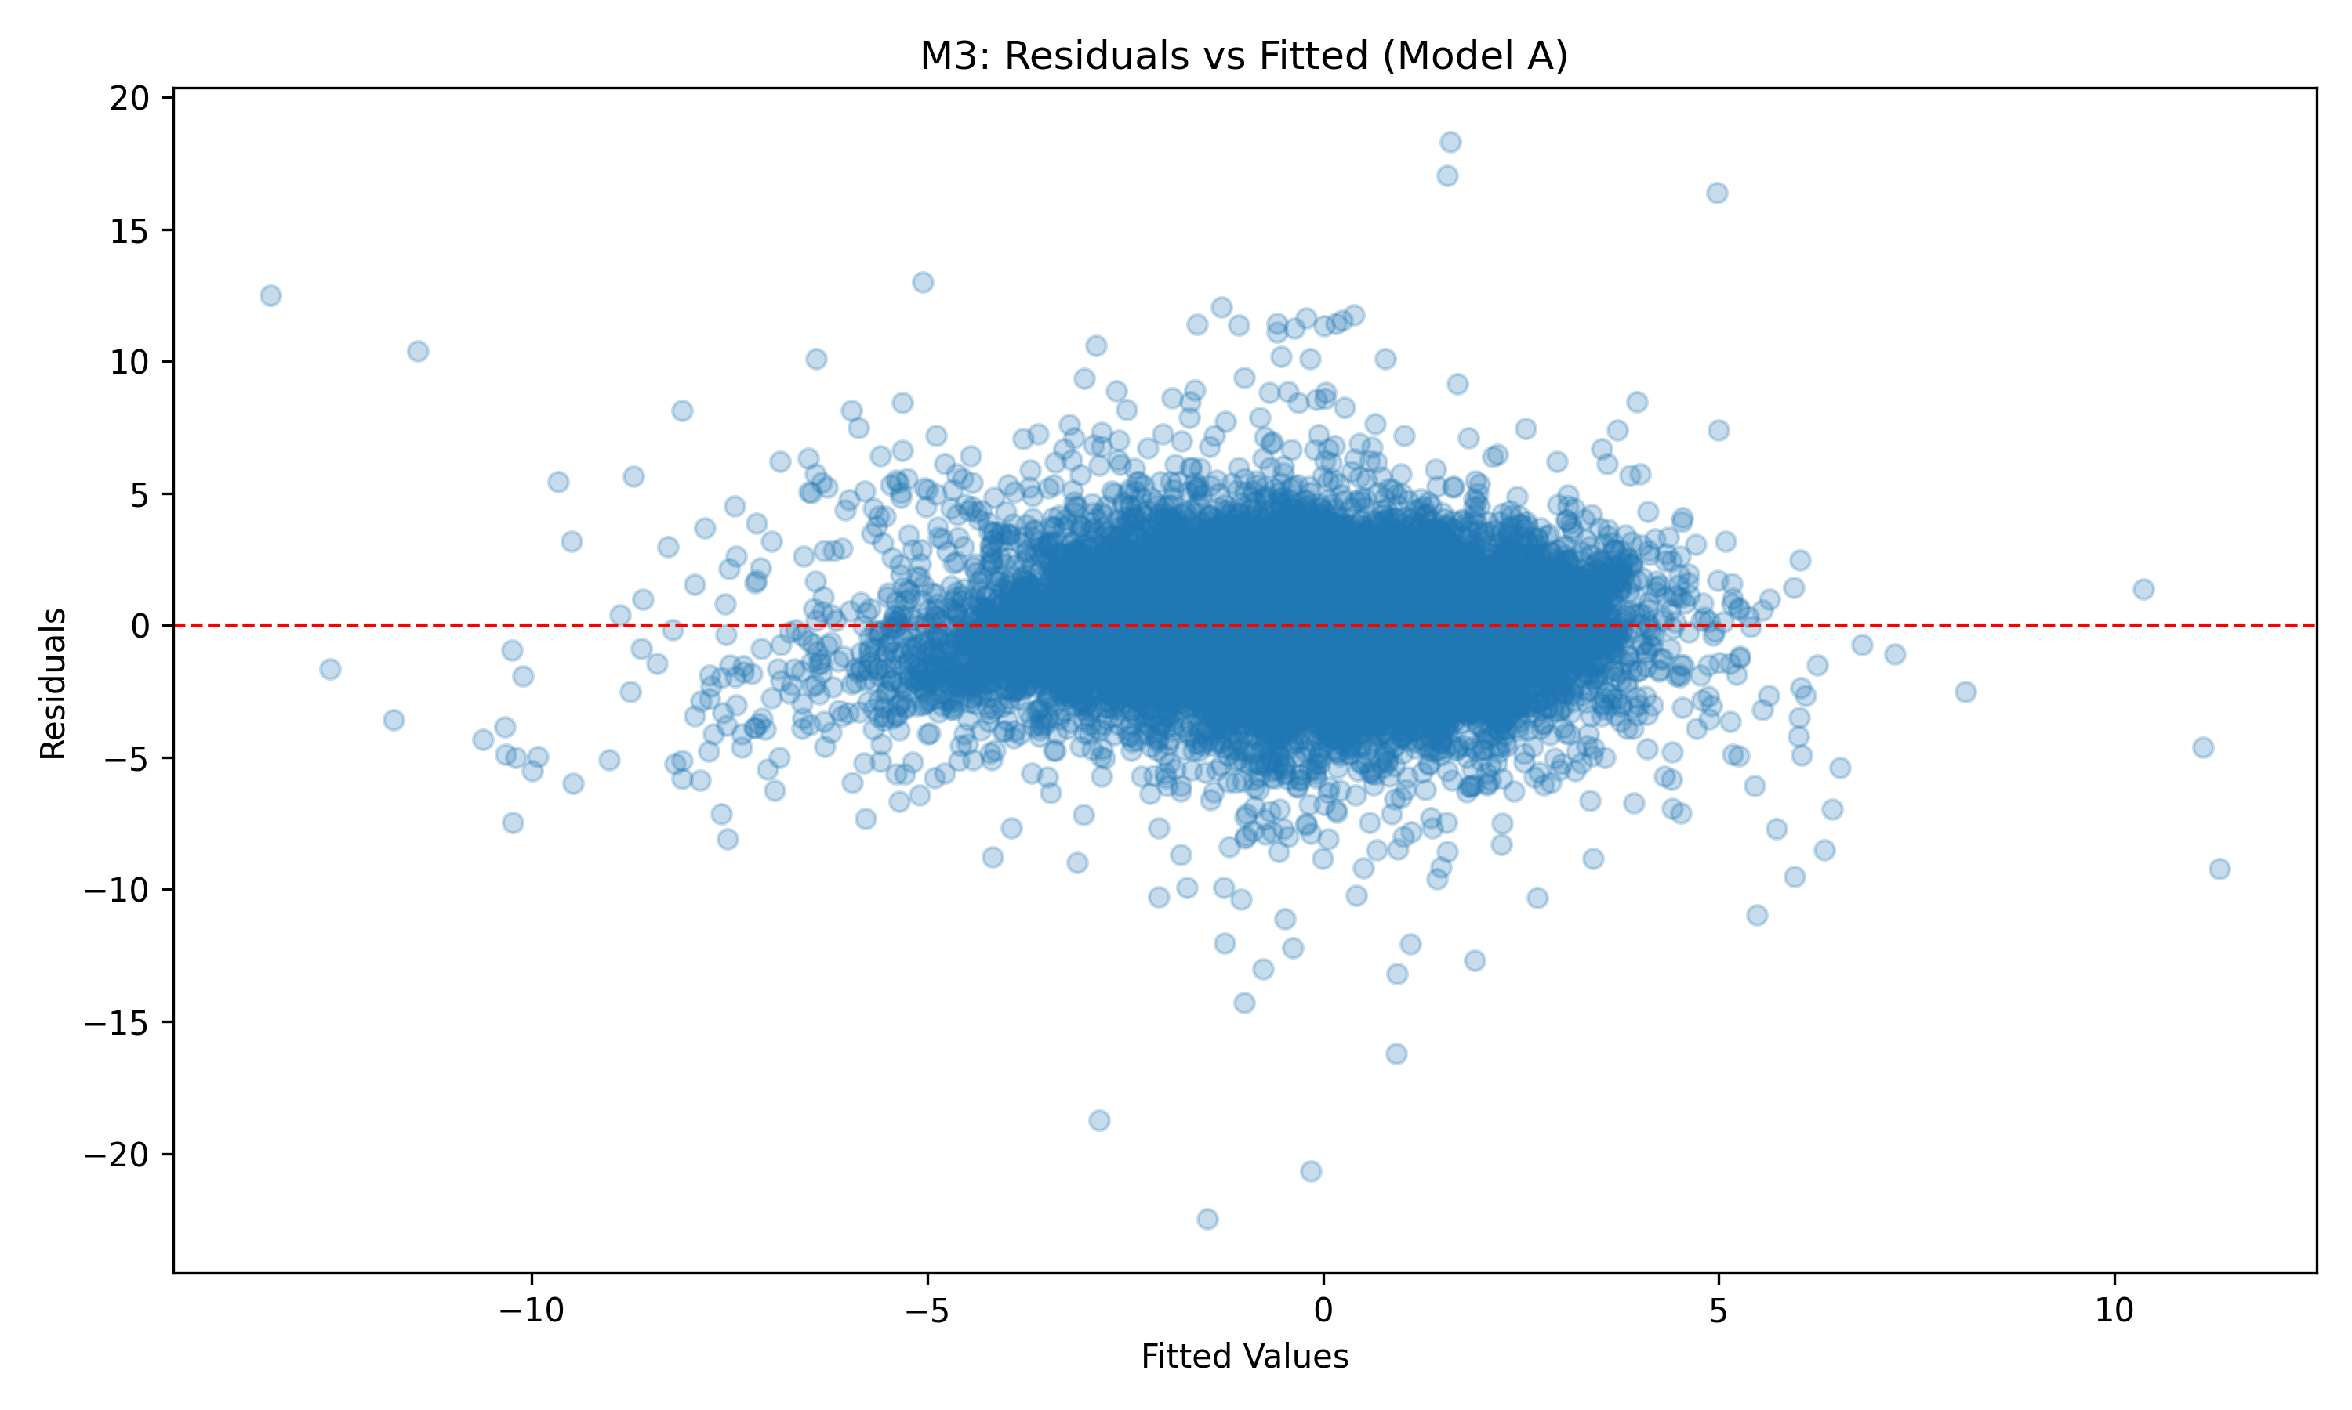
Model Diagnostics: Residuals & Fit
Model Quality:
Residuals are randomly scattered—the model captures the true relationship
46% of price variation explained by rates and momentum—a strong fit for real-world metro data
Results are robust to outliers and statistical variations—findings are reliable

Slide 9
Policy Recommendations
Recommendation 1: Preserve Borrower Affordability
Mortgage tightening reduces quarterly rate-sensitive metro price growth by 0.11 percentage points per 1 percentage point. Target support for moderate-income buyers in suburban and exurban areas to prevent credit stress.
Recommendation 2: Monitor Regional Heterogeneity
The gap between rate-sensitive and resilient metros is large. Avoid one-size-fits-all guidance; calibrate support programs to local rate exposure and supply elasticity.
Recommendation 3: Use Scenario Planning
The housing market remains sensitive to rate policy moves. Evaluate policy changes with scenario analysis rather than aggregate guidance to capture regional variation.

Slide 10
Key Takeaways
Mortgage rates drive metro housing price growth (1 percentage point increase → 0.11 percentage point reduction)
Regional markets diverge: suburban areas show 4× greater rate sensitivity
Model A is robust; DiD results suggest cautious directional evidence
Policy should prioritize targeted affordability support and continuous monitoring
QM 2023 Capstone | Milestone 4 | April 29, 2026

